Slide 1
Out-of-Home Advertising(OOH) as an Enabler of Business Growth in a Downturn
A Presentation by Omo Kingsley Abunene
@ The National Advertising Conference, 2025

Slide 2
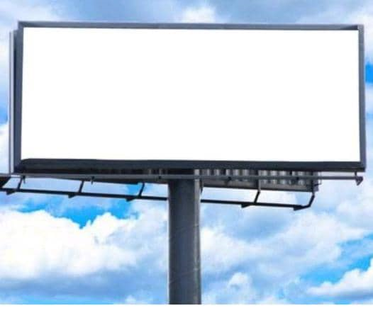
Out-of-Home(OOH) Advertising
Any advertising display encountered outside our home, is out-of-home advertising. It is the oldest advertising form, and continuously gives brands the desired visibility in the real world.

Slide 3
Overview of OOH Advertising in Nigeria
Today, amid Nigeria's ongoing economic downturn—with soaring inflation, Naira instability, forex shortages, and shrinking consumer budgets—we see OOH not just as a survival tool but as a key driver for our clients' business growth and our own resilience.

Slide 6
OOH Effectiveness survey conducted by Geopoll in 2020
- Ranked OOH very high.
79% of people noticing billboards weekly,
63% recalling brands, and OOH sparking actions like online searches
69%, app downloads, purchases, and shares
—often outperforming TV and online. As the second-most effective medium after radio.

Slide 7
Benefits of OOH Advertising
- High visibility and reach
- Ability to target specific audiences
- Primary ad platform
- Not intrusive
- No ad blockers
- No remote controls
- Subscription not often required

Slide 8
Challenges
- Inadequate Data-Driven Insights: Limited access to granular audience data hinders advertisers' ability to measure ROI and justify larger OOH budgets.
- Regulatory Uncertainties: Inconsistent regulations and taxation policies create uncertainty, affecting the industry's growth.
- Delayed Payments: Untimely payments for services rendered impede business continuity for some providers.
- Clutter and Sanitation: Billboard cluttering remains an issue, requiring industry-wide efforts to address

Slide 9

Enablers of Business Growth
Several factors or elements support and facilitate the expansion and success of businesses. They're the building blocks that help companies increase revenue, market share, and profitability.
Examples of enablers include;
Technology,
Talent,
Marketing, Partnerships, and Access to funding. .

Slide 10
Marketing as an Enabler of Business Growth
Marketing is a key enabler of business growth, and this is done through the famous Marketing 4 & 7Ps:
Product,
Price,
Place,
Promotion - Advertising(OOH Advertising)
People, Process, and Physical Evidence

Slide 11
OOH as a Business Enabler
- Promotes Commerce by:
- Creating awareness: Introduces products/services to potential customers, highlighting their benefits and features
- Building brand identity: Helps establish a brand's image, voice, and values, making it more relatable and memorable.
- Driving demand: Encourages people to try new products/services, increasing demand and driving sales

Slide 12
The Advertiser- OOH- Target Audience
Advertiser’s expectations:
- Engagement: Encourage audience engagement and interaction
- Brand awareness: Increase recognition and recall of the brand
- A.I.D.A.

Slide 13
Economic Downturn
An economic downturn is a period when the economy experiences a decline or slowdown in activity, often characterized by:
- Reduced economic activity,
- Decreased consumer spending,
- Job losses,
- Business closures,
- Increased poverty.

Slide 14
Economic Downturn- Impact on OOH
- Survival mode is activated
- Priorities are reordered
- Non- essentials take the back seat
- Budgets are impacted

Slide 15
Likely Impact on the Target Audience
- Reduced disposable income: Job losses, and decreased income can lead to less money available for non-essential spending
- Increased price sensitivity: Consumers become more price-conscious, seeking affordable options and discounts.
- Shift in priorities: Essential expenses (food, healthcare, education) take precedence over discretionary spending (entertainment, travel)

Slide 16
Delivering Effective OOH Campaign in a Downturn
- Essential Factors to Consider
1. Profiling and Audience Targeting:
Understanding the demographics, behaviors, and preferences of the target audience allows advertisers to tailor their messages accordingly. Relevant and targeted content increases the likelihood of engagement and conversion.
Use Data-Driven Insights: Leverage audience tracking and analytics to inform advertising decisions

Slide 17
2. Strategic Placement:
- Identifying high-traffic locations where the target audience is likely to see the ad is crucial.
Strategic placement ensures maximum exposure and potential engagement.
- Location selection:

Slide 18
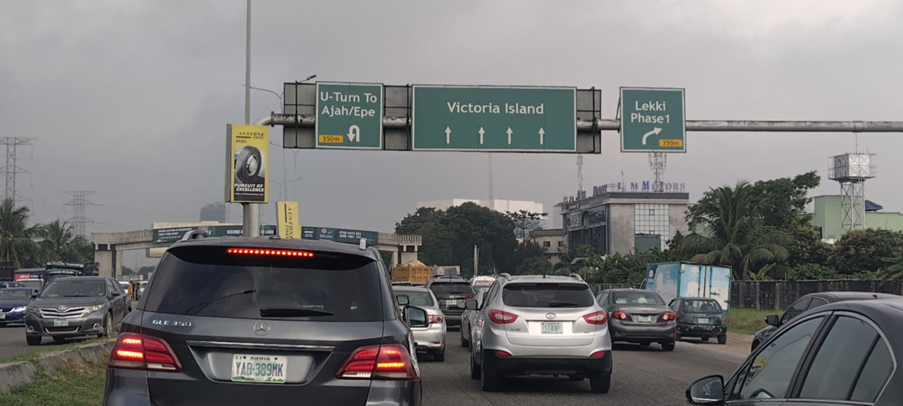
OOH Advertising in Downturns
Directional Signs - Essential in City Commutes

Slide 19
1️A man crawling in the desert, dying of thirst
2 He drinks Coke
3 He walks away, happy and refreshed
3. Creative and Relatable Content: Avoid Copy & Paste
Coca-Cola once ran an ad in the Middle East-It had 3 images:
One problem:
They didn’t flip the layout for Arabic - Arabic is read right to left.
So in that market, the ad told a very different story:.

Slide 20
3. Creative and Relatable Content:
Advertisers will need to adjust their strategies to resonate with the target audience's new realities:
- Emphasize value and affordability: Highlight cost-effective solutions, promotions, and discounts
- Focus on essential benefits: Showcase how products/services address basic needs, improve quality of life, or offer long-term value
- Empathetic messaging: Acknowledge the challenges and offer supportive, reassuring communications

Slide 21
4. Integration with Digital Channels:
Integrating OOH campaigns with digital channels like social media and mobile platforms enhances reach and engagement. Using QR codes, hashtags, or interactive elements encourages audience interaction and amplifies the campaign's impact.

Slide 22
5. Consistency and Frequency:
Maintaining a consistent presence and frequency of OOH ads over time reinforces brand awareness and message recall among the audience.
- Repetition plays a significant role in influencing consumer behavior.

Slide 23
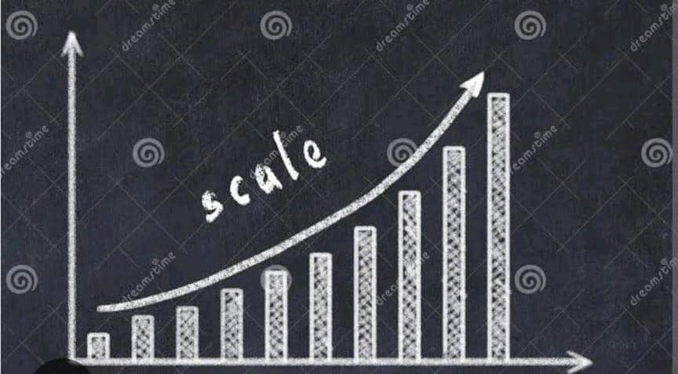
6. Measurement and Analytics:
Robust measurement and analytics tools to track the effectiveness of OOH campaigns is essential. Tracking the performance of OOH campaigns is vital for evaluating ROI.
Metrics such as
foot traffic,
brand recall,
and website visits
help gauge the effectiveness of the advertising efforts.

Slide 24
Some OOH Advertising Cost-effective Strategies:
- Data-Driven Insights: Analytics that optimize ad placement, measure engagement, and inform future campaigns.
- Programmatic OOH: Enables real-time bidding and audience-based buys, increasing ad effectiveness and ROI.
- BRT OOH: Mobile ads, driving engagement and conversions.
- Indoor OOH: Targets high-income audiences in premium spaces like airports, malls, and cinemas, offering high dwell times and engagement.-

Slide 25
Some OOH Cost-effective Strategies in a Downturn
- Short-term campaigns: Run shorter campaigns (1-3 Months) to create buzz and maximize impact.
- Lamposts -
- Small formats

Slide 26
Case Study 1
The iconic Coca Cola ad during WW2 is a legendary case study in marketing and branding!
During WW2, Coca Cola became a symbol of American culture and patriotism. The company's ads often featured soldiers, families, and the iconic bottle.
One notable ad shows a soldier writing a letter home, with a Coca Cola bottle on the table. The caption reads: "I'd like to teach the world to sing... and keep the world happy with Coca Cola!"
This ad campaign helped Coca Cola:

Slide 27
Case Study 1
- Boost morale: Soldiers and civilians alike felt connected to home and comfort
- Increase brand recognition: Coca Cola became synonymous with American values
- Expand globally: International markets opened up, setting the stage for future growth
The campaign's themes of:
- Patriotism
- Nostalgia
- Inclusivity
are still used in advertising today!

Slide 28
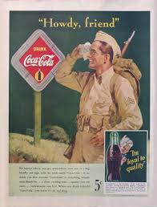
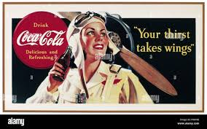
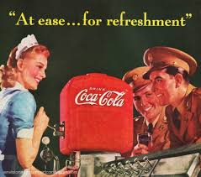
Coca Cola OOH Ads during WWII

Slide 29
Case Study 2
KUDA 2019/2020 campaign that ran into the pandemic storm
• Mass awareness (OOH / experiential + giveaways) — as Kuda scaled, they visibly deployed billboards, digital LED sites and street activations in Lagos (promotions like “spot the billboard, win ₦5,000” and the hashtag #KudaOnTheStreets). That shows a deliberate shift to offline mass-reach channels.

Slide 30
Case Study 2
KUDA 2019/2020 campaign that ran into the pandemic storm
• Multiple billboard placements in Lagos, including visible placements at high-reach sites such as Lekki Gateway (marketing/media owner posts and Kuda social posts). These posts explicitly announced Kuda billboards and run social giveaways tied to spotting them.

Slide 31
Case Study 2
KUDA 2019/2020 campaign that ran into the pandemic storm
• Social posts and hashtag campaigns promoted OOH directly (spot-and-win mechanics), which is a classic way to amplify OOH by driving social UGC (user generated content). Results included:
- Achieved massive awareness
- Increased market share

Slide 32
Conclusion
- OOH advertising is a powerful tool for businesses in Nigeria, offering a way to reach and engage with customers, drive sales, and achieve growth even in challenging economic times.

Slide 33
THANK YOU

