Slide 1
Customer Retention & Lifetime value (LTV)
Turning Existing Customers into Sustainable Revenue in Tough Times
Presenter: Tosin Oyedeji
COO, BrandEye Media

Slide 2






Outline
Nigeria’s market context (inflation, digital, trust)
Why retention > acquisition (ROI focus)
Understanding LTV framework
Practical tactics: Personalization, Loyalty programs, Omnichannel, Feedback & Service quality
Case examples: Telco, FinTechs, banks
Key takeaways for sustained revenue

Slide 3
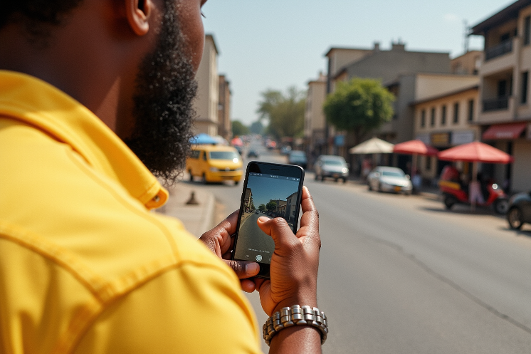
Nigeria Market Dynamics (Inflation, Digital, Trust)
High inflation & cost pressure
Mobile-first digital adoption
Value & trust focus
85%
>69.2%
99%
of Nigerians cite cost-of-living (food, fuel) as a top concern
mobile penetration; 45.5% for internet connected devices. Digital payments and apps (fintech) are growing fast.
of consumers say brand trust (quality/ consistency) is very important. Customers now trade up for perceived value and reliability.
https://businessday.ng/technology/article/gen-z-fuels-nigerias-digital-retail-revolution-says-nielseniq/#:~:text=Oluwatosin%20Onayemi%2C%20Senior%20Manager%2C%20Retail,impact%20has%20started%20to%20ease
https://techcabal.com/2025/09/05/nigeria-smartphone-market-recovery-q2-2025/#:~:text=Increasing%20smartphone%20penetration%2C%20which%20stood,first%20customers

Slide 4



Retention vs Acquisition: ROI Advantage
Cost of acquisition: Gaining a new customer can cost 5–7× more than keeping an existing one.
Focus marketing spend on current customers
Stable revenue: In tough times, maximizing what you have (repeat purchases, cross-sell, upsell) builds sustainable revenue without heavy new acquisition costs.
Retention boosts profit: A 5% lift in retention rates can increase profits by 25–95.
Retained customers spend more over time

Slide 5





Understanding Customer Lifetime Value (LTV)
What is LTV?
The total revenue (profit) a customer generates over their relationship with your company
LTV formula:
(Avg. Purchase × Gross Margin × Purchase Frequency × Customer Lifespan) – CAC
Grow LTV:
Increase repeat visits, cross-sells, up-sells and reduce churn to boost LTV
Guide for investment:
Aim for LTV/CAC > 3:1 (for every 1 spent acquiring a customer, you should earn 3 back)

Slide 6





Retention Tactic: Personalization
Segment & Tailor:
Use CRM data and analytics to tailor products/offers by customer segment (e.g., loyalty tiers, behavior)
Personalized Communication:
Send targeted messages (SMS, email, app push) with relevant content/offers. Address customers by name, reference past purchases
Adaptive Products/Services:
Adjust offerings to fit local tastes or economic realities (e.g., mobile plan bundles for specific income groups)

Slide 7





Retention Tactic: Loyalty Programs & Incentives
Cashback & points: Use instant-value rewards (cashback, airtime credit, vouchers) which resonate in a cash-strapped economy
N290M
Total in cash prizes were given to pre-paid subscribers through MTN’s “Mega Billion” promo, boosting engagement.
Integrated payments loyalty: Link shopping + payments (e.g., JumiaPay points on purchases) to keep customers in your ecosystem
https://bhmng.com/telecom-tariffs-mtn-nigeria-rewards-customer-loyalty-in-mega-billion-promo/#:~:text=In%20this%20context%2C%20the%20promo,be%20both%20valuable%20and%20rewarding

Slide 8

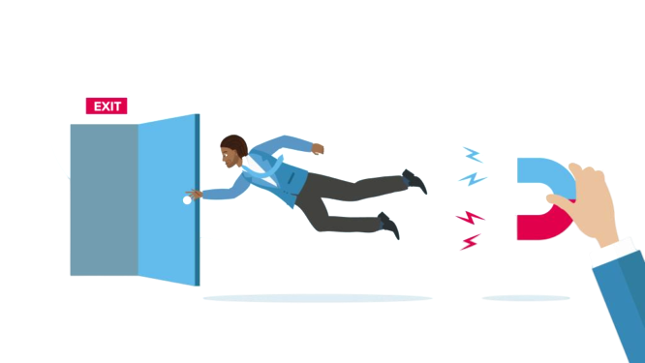


Retention Tactic: Omnichannel Engagement
Seamless experience:
Ensure customers get the same deal and service across channels (branch, mobile app, website, social media). Use your data in each channel
Mobile-centric outreach:
Given Nigeria’s mobile-first behavior, engage via SMS, USSD, WhatsApp and mobile apps
Value-added cross-sell:
Use every touchpoint to add services (e.g., banks offering insurance via app, telcos bundling e-wallets). Empower stores/call centers to upsell relevant add-ons

Slide 9
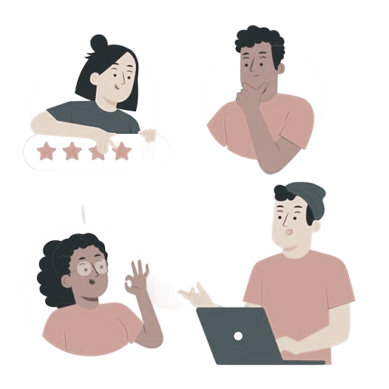


Retention Tactic: Feedback Loops & Service Quality
Listen & Act:
Regularly solicit feedback (surveys, social media, app reviews) and visibly act on it. Close the loop to show customers they are heard
Community engagement:
Build online forums or WhatsApp groups for top customers. Monitor complaints and praise on social media. Use data analytics to identify churn signals
Excellence in service:
Train staff for empathy/ efficiency.
Kuda Bank, for example, uses proactive communication and empowers customers to self-serve simple issues. Surprise-and-delight tactics (unexpected perks for loyal users) also reinforce trust.

Slide 10




Examples
MTN Nigeria (Telecom)
Other ISPs & Retail
Fintech & Banks
51% market share 84.6M subs). Retention via network quality, customer incentives. Runs mega-promotions (e.g., Mega Billion) to reward usage. Strong brand and rural coverage foster loyalty
ISPs like Spectranet use “Jara” points to surprise loyal customers (e.g. free broadband boosts). Even offline retailers (e.g. Wakanow travel) give gifts to repeat visitors
JumiaPay’s integrated loyalty keeps users within its platform. Digital banks (e.g. Kuda, PiggyVest) offer bonus returns or referral rewards.
PiggyVest, for example, combines savings features with bonuses, tapping into Nigeria’s youth mindset.
Key lesson:
These brands tie loyalty directly to value (cashback, convenience, surprises), reinforcing retention through tangible benefits

Slide 11







Key Takeaways
Prioritize retention: In Nigeria’s high-cost environment, retaining customers delivers greater ROI than chasing new ones. It stabilizes revenue when acquisition budgets are tight
Use LTV as guide: Calculate LTV to justify spend on retention. Keep LTV/CAC ratios healthy (aim >3:1). Focus on metrics like churn rate, repeat purchase rate
Tactics matter: Deploy personalization, rewards, omnichannel and top-notch service in combination to deepen loyalty. Customize each tactic to local culture and digital habits
Leverage technology: Nigeria’s mobile penetration means SMS/ USSD/app-based retention programs work best. Use data/ AI for segmentation and timely offers
Learn from others: MTN, Nigerian banks and fintechs show how to engage customers in context. Emulate what works here (e.g. instant rewards, finance product add-ons)
Outcome: Loyal customers become brand advocates and revenue anchors. By nurturing them, businesses gain resilience in tough markets

Slide 12

Questions & Discussion

